Slide 1
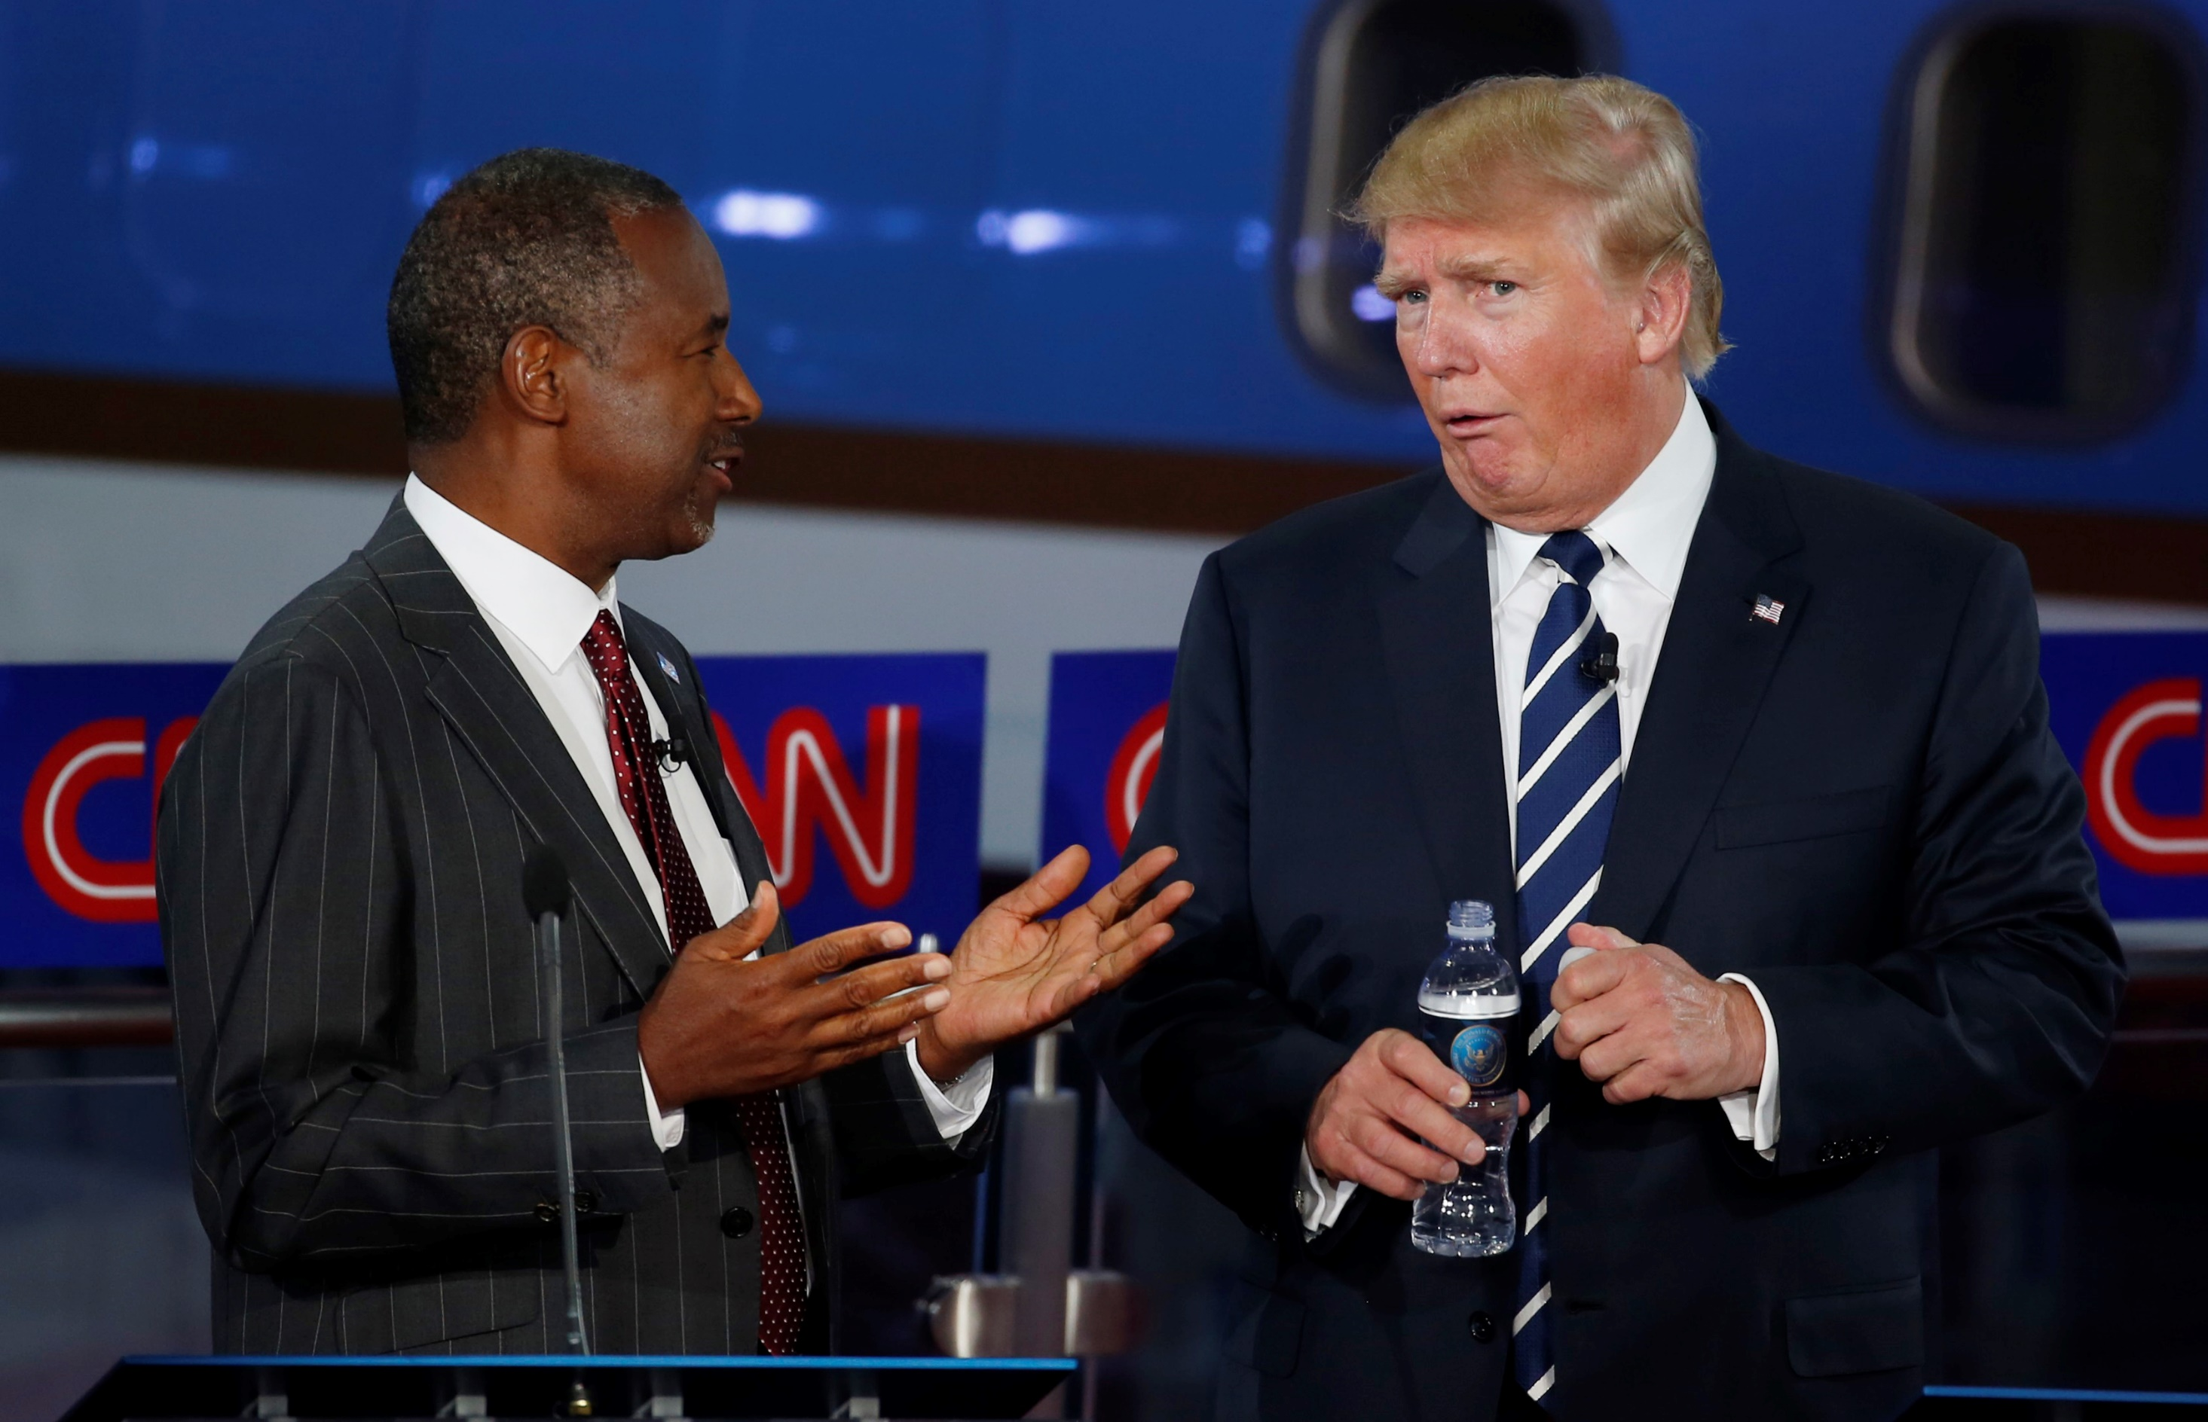


Advising Political Campaigns
Camille Blain-Coallier – Alfonso Bucag – Nayla Fakhoury - Juan Pablo García - Rafael Hernández – Irune Maury – Demetris Perdikos
Group C

Slide 2



The can't-miss 2019 calendar for 2020 candidates
Jan
Sept
Oct
Feb
Mar
Jun
Jul
Q1 fundraising quarter ends
2nd DNC-hosted debate
4th DNC-hosted debate
Q1 fundraising quarter begins
1st DNC-hosted debates begin
Politics and Eggs Forums
3rd DNC-hosted debate
Notes:
Washington (CNN)We may not know yet which Democrat will compete against President Donald Trump in 2020, but we do know where the candidates will turn up in 2019.

Slide 3

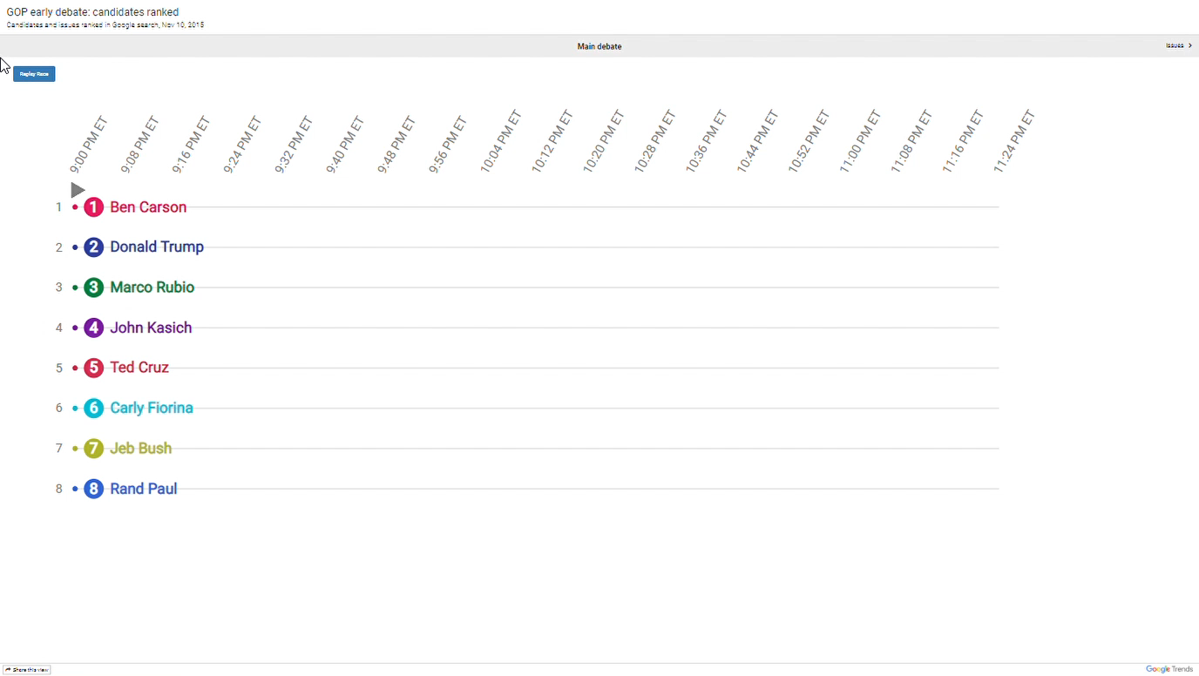

Grand Old Party Debate: 2016

Slide 4





The roadmap to presidency
How they feel
What they say
What should I say
Sentiment Analysis
Language Modeling
Language Modeling
Naive Bayes
MaxEnt
Neural Net
LSTM
N-gram Pr.
N-gram Pr.

Slide 5
The roadmap to presidency
How they feel
What they say
What should I say
Sentiment Analysis
Language Modeling
Language Modeling
Naive Bayes
MaxEnt
Neural Net
LSTM
N-gram Pr.
N-gram Pr.

Slide 6
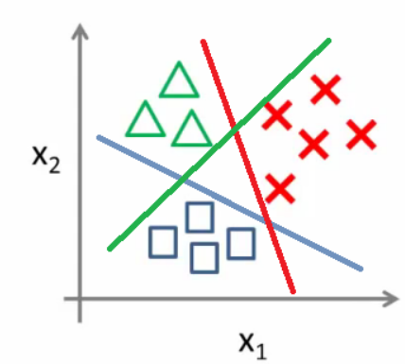
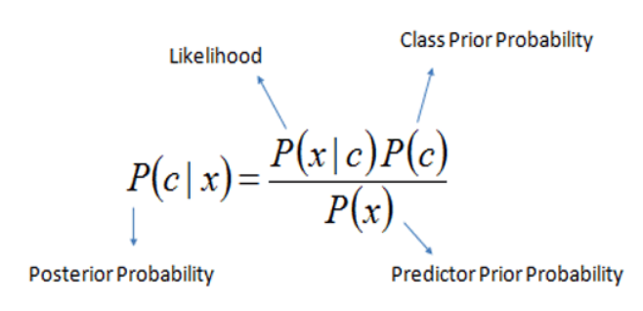
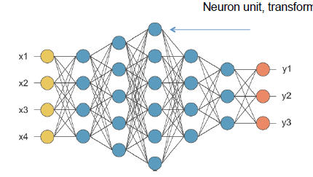
Sentiment Analysis
How they feel
1
2
Initial Processing
Hashtags, Emoticons,
Usernames, URLs, Repetitions
NLP Techniques
TF-IDF
Word2Vec
MaxEnt Classifier
Naïve Bayes
NLP Techniques
Stemming, N-grams,
POS Tagging, Negations,
SentiWordNet
Neural Network
MaxEnt Classifier

Slide 7
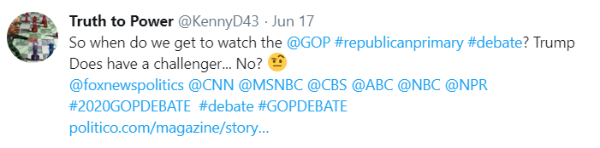
How they feel
Initial Tweets Pre-processing
Emoticons
Hashtags
Punctuations
Usernames
URLs

Slide 8
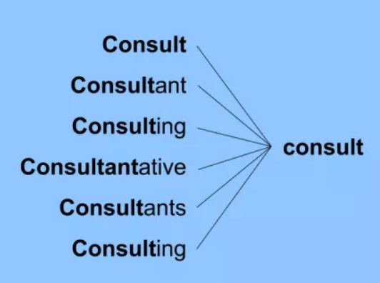
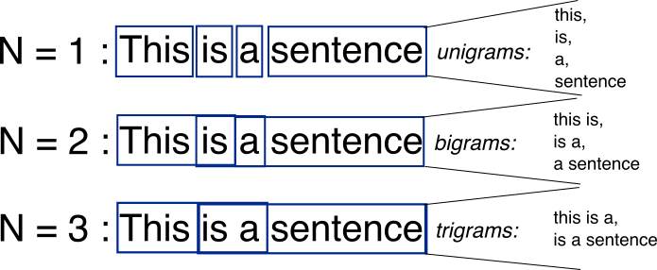
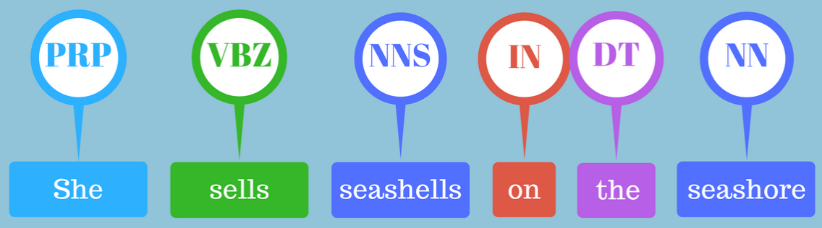
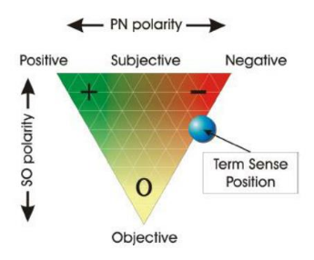
NLP Techniques
How they feel
Never No Nothing
Not Haven't Can’t
Couldn’t Won’t Don’t
Didn’t Isn’t Aren’t
1
2
3
Stemming
N-grams
Negations
4
5
POS Tagging
SentiWordnet

Slide 9
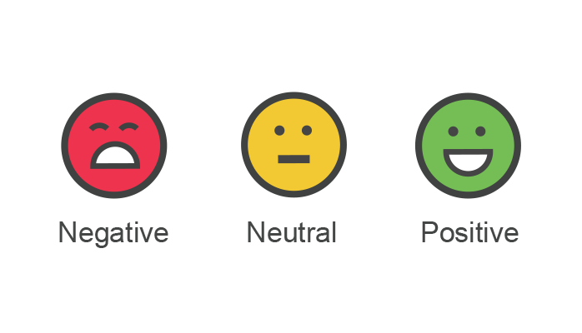
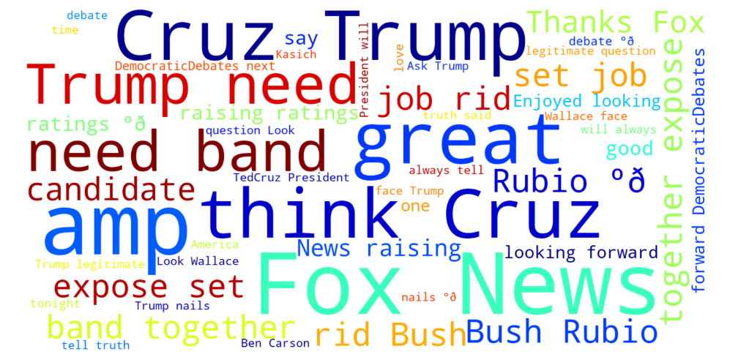
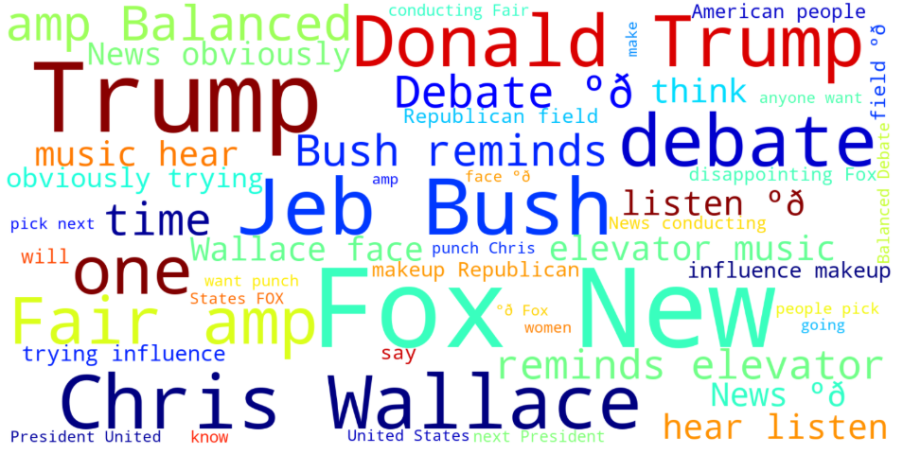
Sentiment Analysis – Word count
How they feel

Slide 10
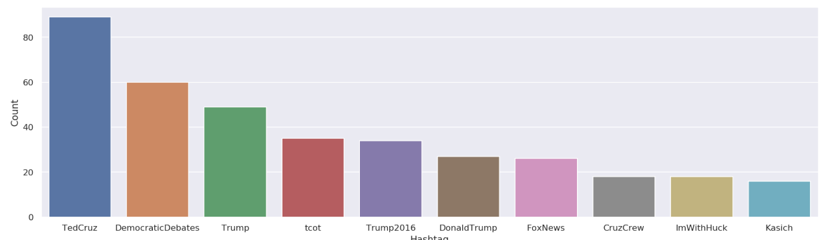
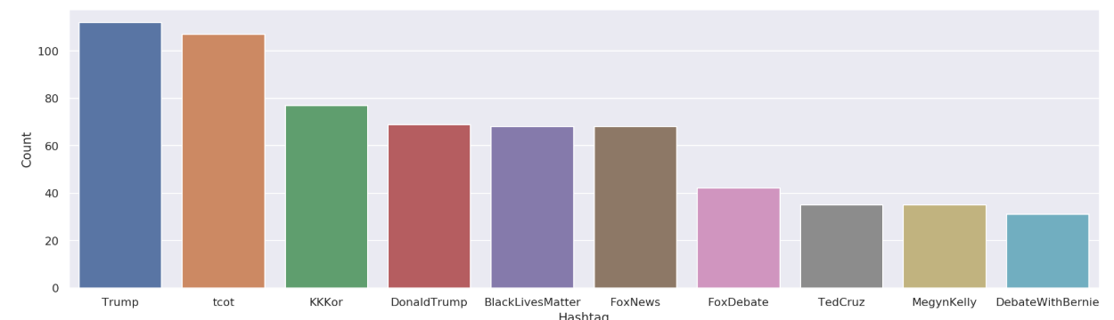
Sentiment Analysis – Hashtag count
How they feel

Slide 11
The roadmap to presidency
How they feel
What they say
What should I say
Sentiment Analysis
Language Modeling
Language Modeling
Naive Bayes
MaxEnt
Neural Net
LSTM
N-gram Pr.
N-gram Pr.

Slide 12

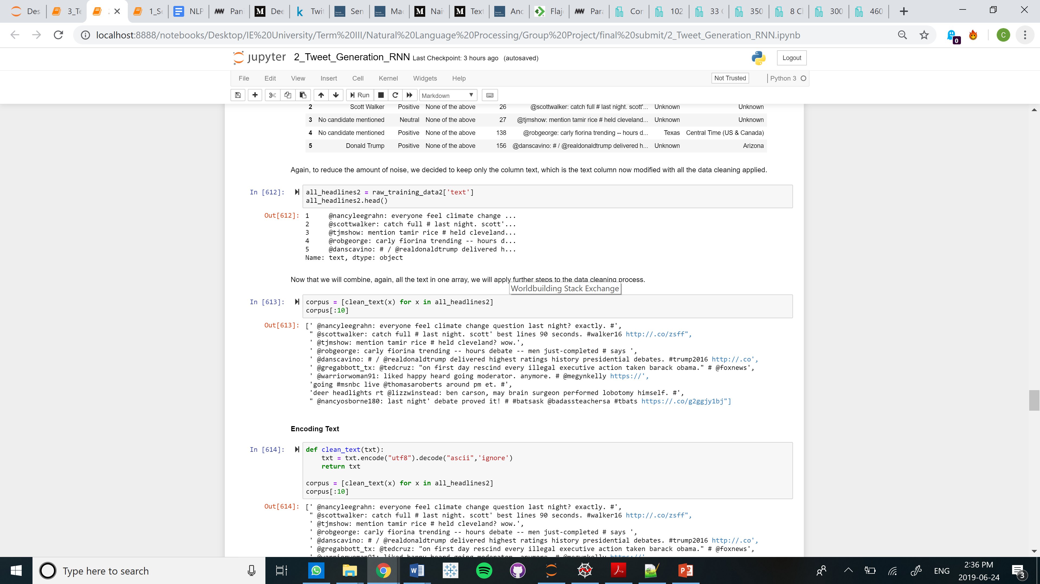
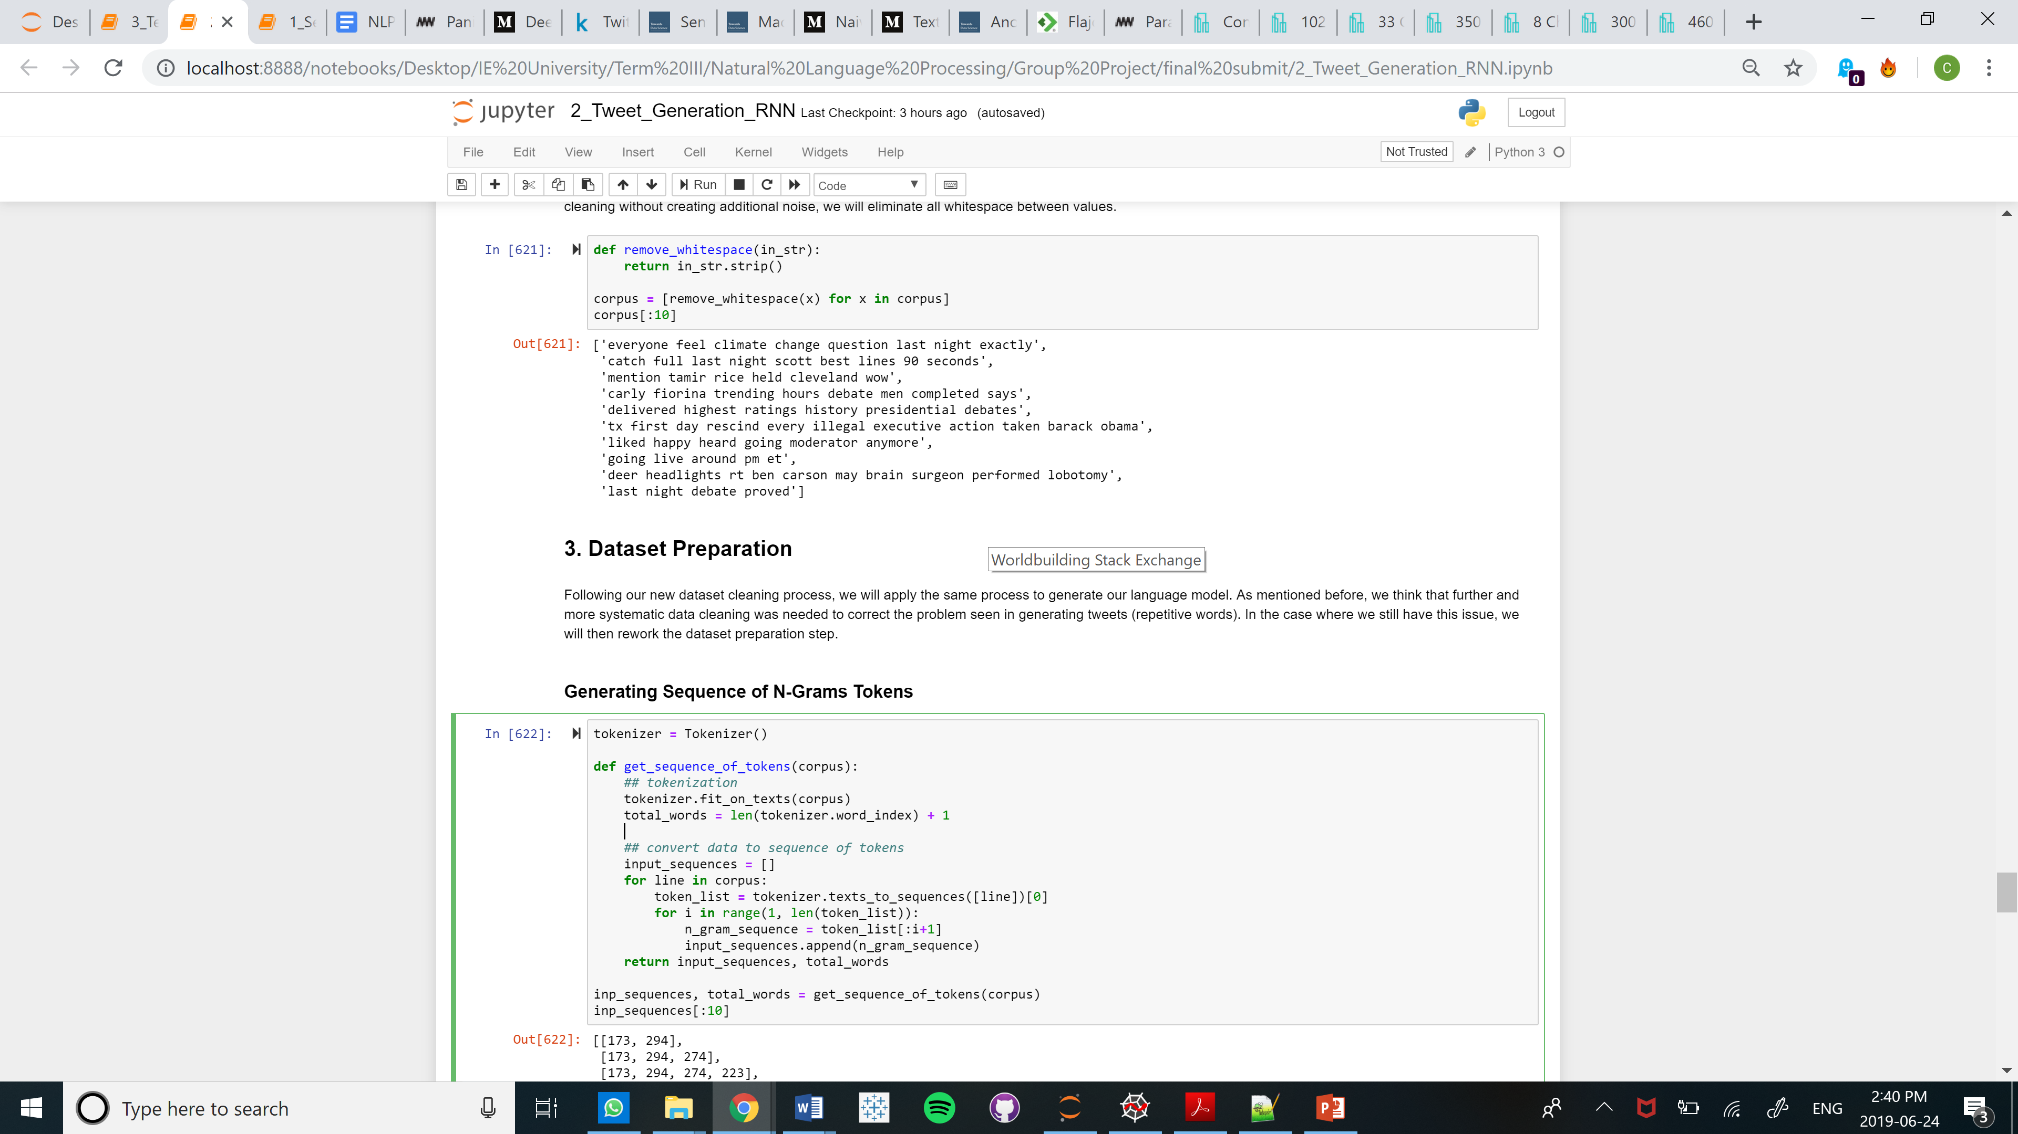
Language Modelling and Text Generation using LSTMs – Deep Learning
What they say
Step 1 to 3
First step: Data Cleaning
Remove Stopwords and Apply Lowercase
Remove Common Words (“gobdebate, gobdebat, gobdeb, Gobdebate, Gobdeb, …”)
Remove words with 1 letter
Remove symbols and punctuation
Remove Link, User and Special Characters
Remove Whitespace
Step 4 to 6

Slide 13
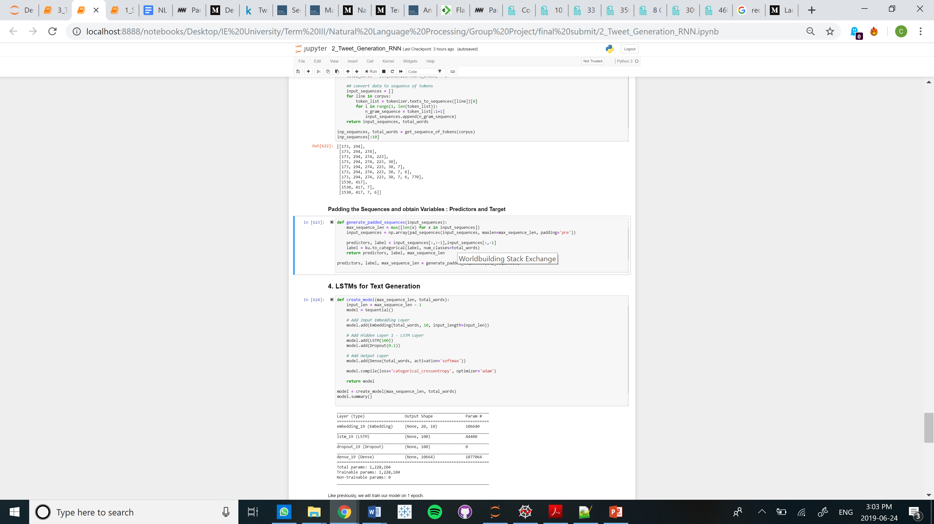
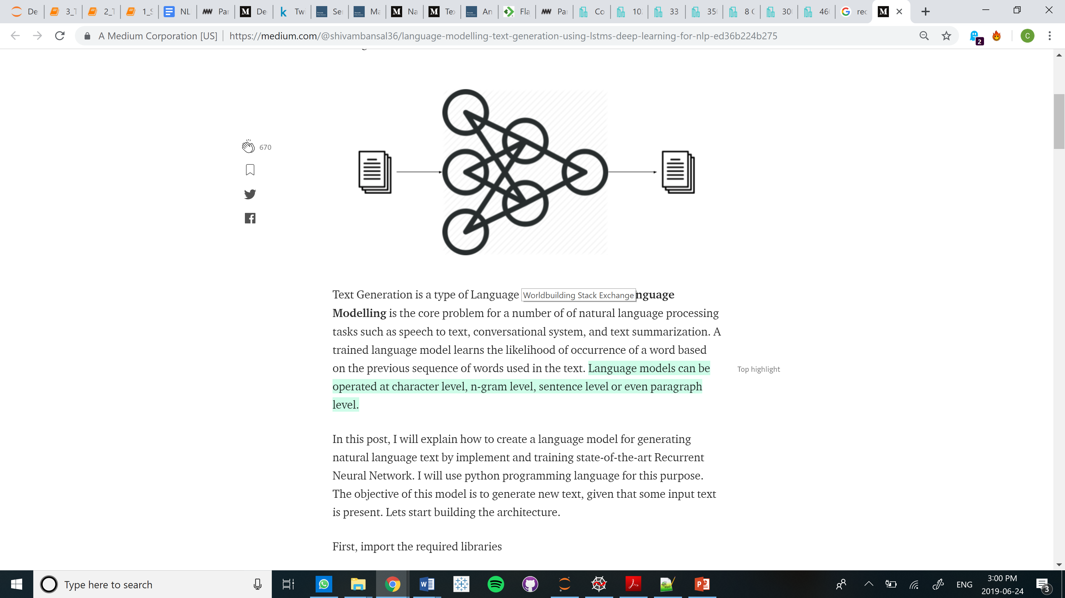
What they say
Second step:
Generate Recurrent Neural Network

Slide 14

Some Results...
What they say
Trump ............
Debate ...........
Climate ..........
President .......
Trump Said Megyn Ask Nine Candidates
Debate Debate Action Fox News Fed
Climate Change Made 90 Issue Next
President Always Tell Truth Said Would

Slide 15

RNN Limitations – Tweet Generation
What they say
Text Generation for Tweets is more difficult as most Tweets are much shorter than texts in general
Running a deep learning model is computationally expensive versus the standard NLP approach
The results could be improved further with the following points:
- Adding more data
- Fine Tuning the network architecture
- Fine Tuning the network parameters

Slide 16



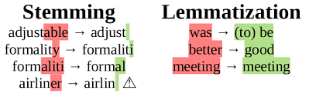

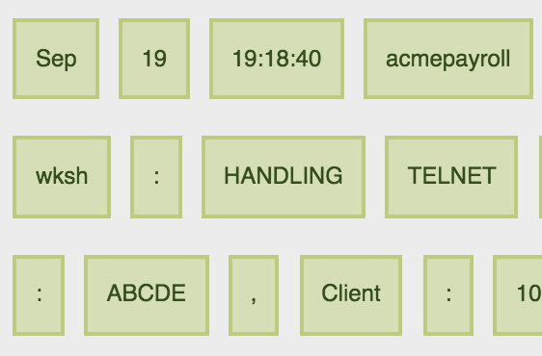



Tweet Generation – N-gram Probabilities
What they say
Preprocessing
Stopwords
Punctuation
Stemm / Lemma
Normalization
WordPunctTokenizer()
Text Generation
Back off Strategy
4 – gram
probability
Tri – gram
probability
Bi – gram
probability
Stop

Slide 17
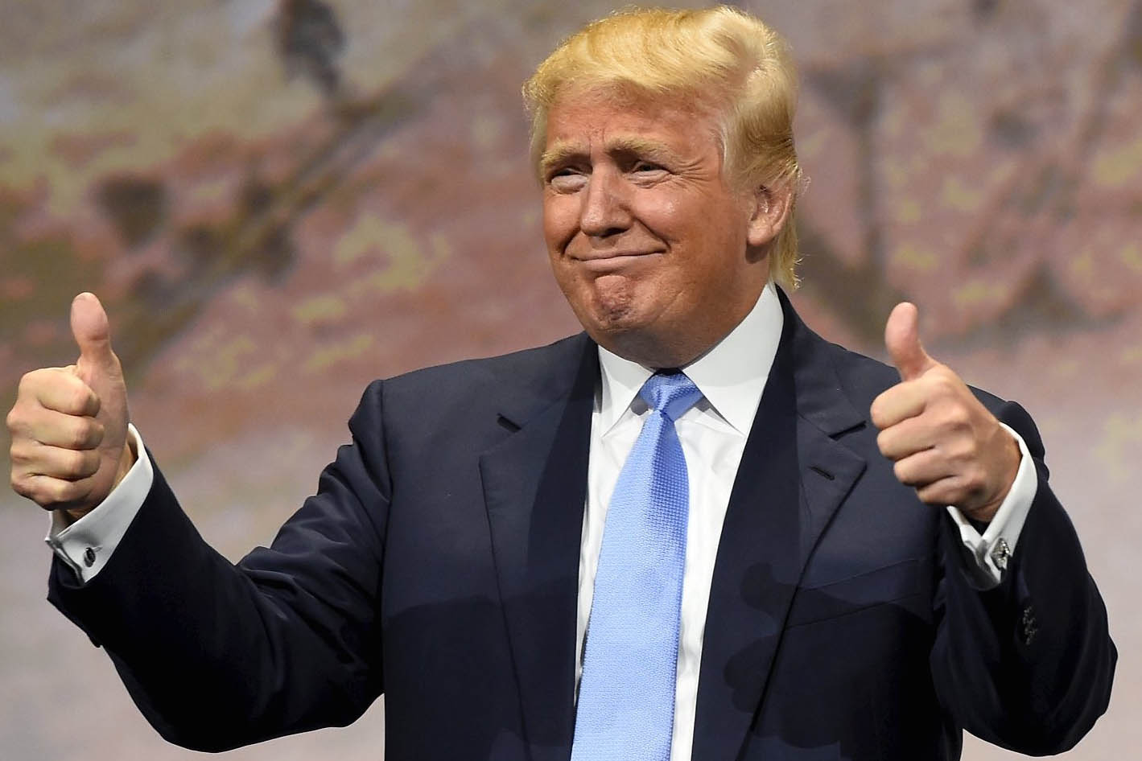
Same Results?
Trump ............
Trump is a......
Trump Said Megyn Ask Nine Candidates
Trump is a pure joke Americans cannot let

Slide 18
The roadmap to presidency
How they feel
What they say
What should I say
Sentiment Analysis
Language Modeling
Language Modeling
Naive Bayes
MaxEnt
Neural Net
LSTM
N-gram Pr.
N-gram Pr.

Slide 19

Tweet & Speech Generation – N-gram Probabilities
What should I say
Preprocessing
Stopwords
Punctuation
Stemm / Lemma
Normalization
WordPunctTokenizer()
Text Generation
Back off Strategy
4 – gram
probability
Tri – gram
probability
Bi – gram
probability
Stop

Slide 20


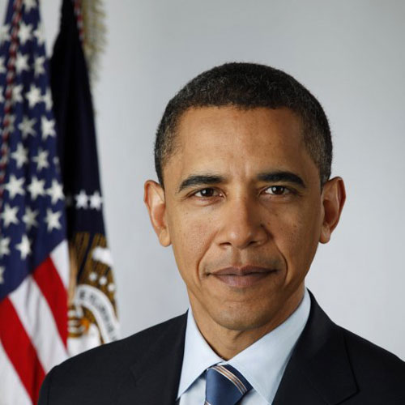
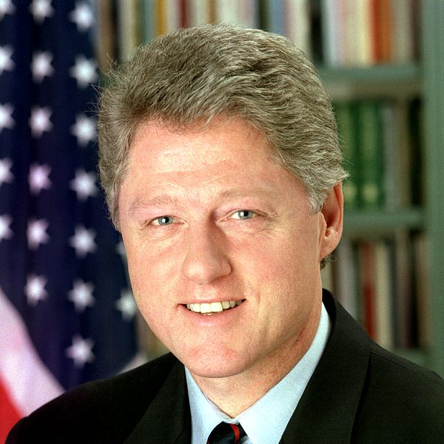
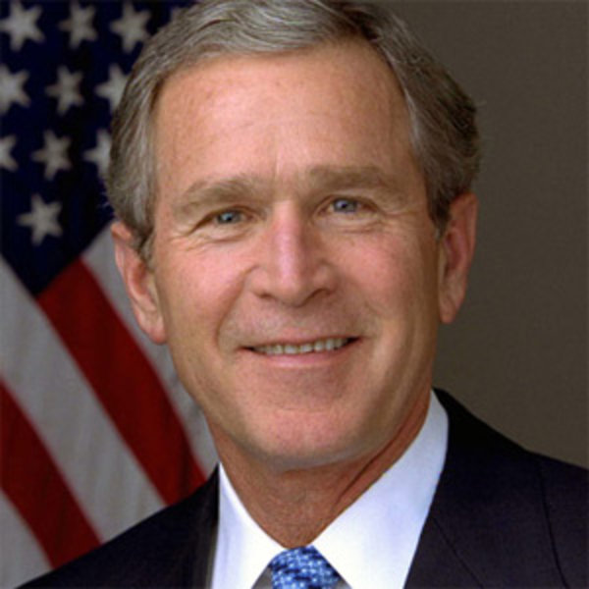


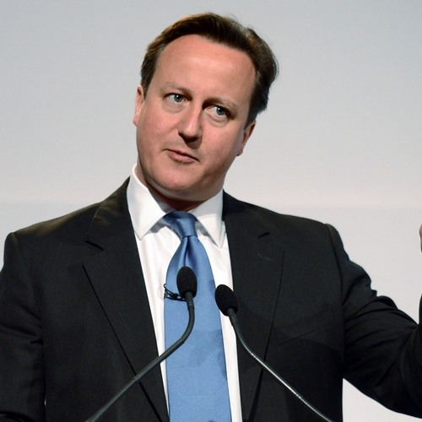
Speech modeling
What should I say
Education
Economy
B. Obama: Education Speech - 2008
B. Clinton: Upenn Speech - 1992
B. Obama: Economy Speech - 2009
G. Bush: Education Campaign Speech - 1999
D. Trump: Jobs & Economy - 2016
D. Trump: Education Quotes - 2015
G. Bush: Economic Crisis - 2008
Ruth Kelly: North of England Education conference - 2005
D. Cameron: Transforming the British economy - 2010

Slide 21
Generating Speech - Education
What should I say
Women’s role is...
the currency of the Information
Women’s role is...
a pleasure to be here
Women’s role is...
a community determined to move
Women’s role is...
living in poverty. If

Slide 22
Generating Speech - Economy
What should I say
The economy is...
investing in ourselves. The
The economy is...
now watching and waiting for
The economy is...
a bold, ambitious,
The economy is...
in danger. So I
The economy is...
heavily reliant on just a

Slide 23
The roadmap to presidency
How they feel
What they say
What should I say
Sentiment Analysis
Language Modeling
Language Modeling
Naive Bayes
MaxEnt
Neural Net
LSTM
N-gram Pr.
N-gram Pr.

Slide 24

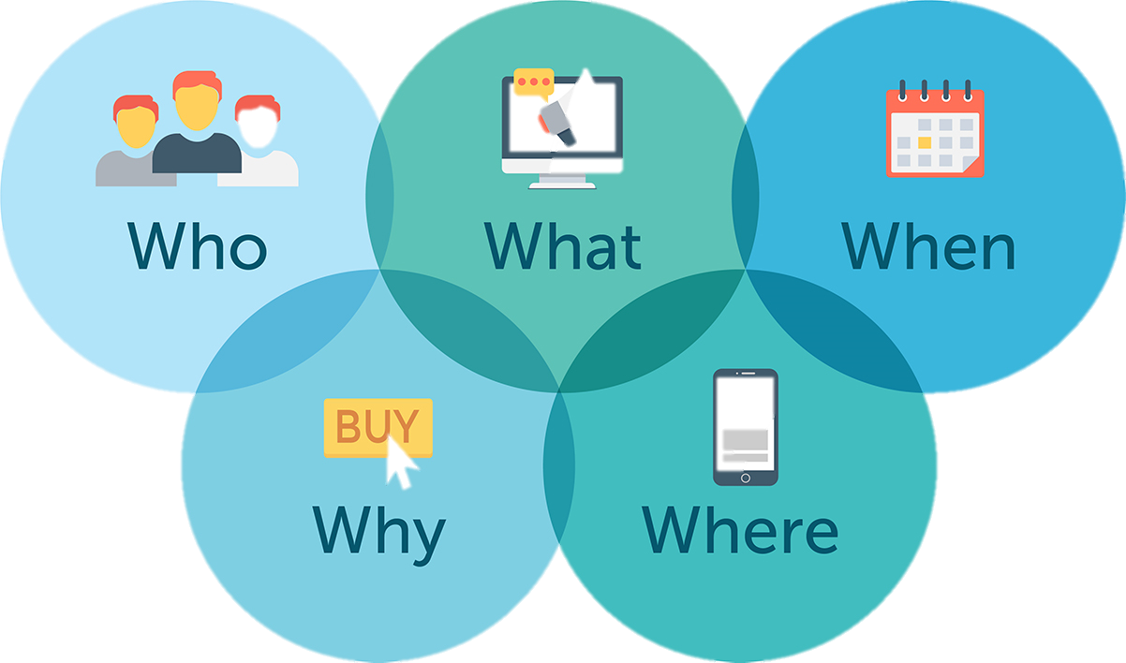

Conclusions and considerations
Understanding the context of an event through NLP techniques
Contextual factors shape the inputs/outputs of analysis.
Replicability and Scalability of NLP techniques for analyzing social media
#Event
#Event
#Event
Context
NLP Techniques

Slide 25
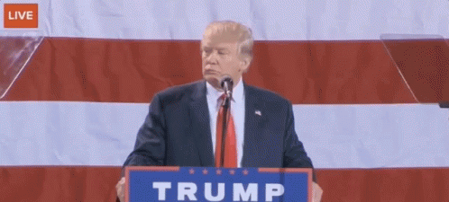

Slide 26
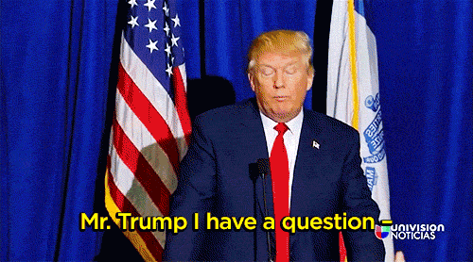
Q&A

